Slide 1
12th Grade Program

Slide 2
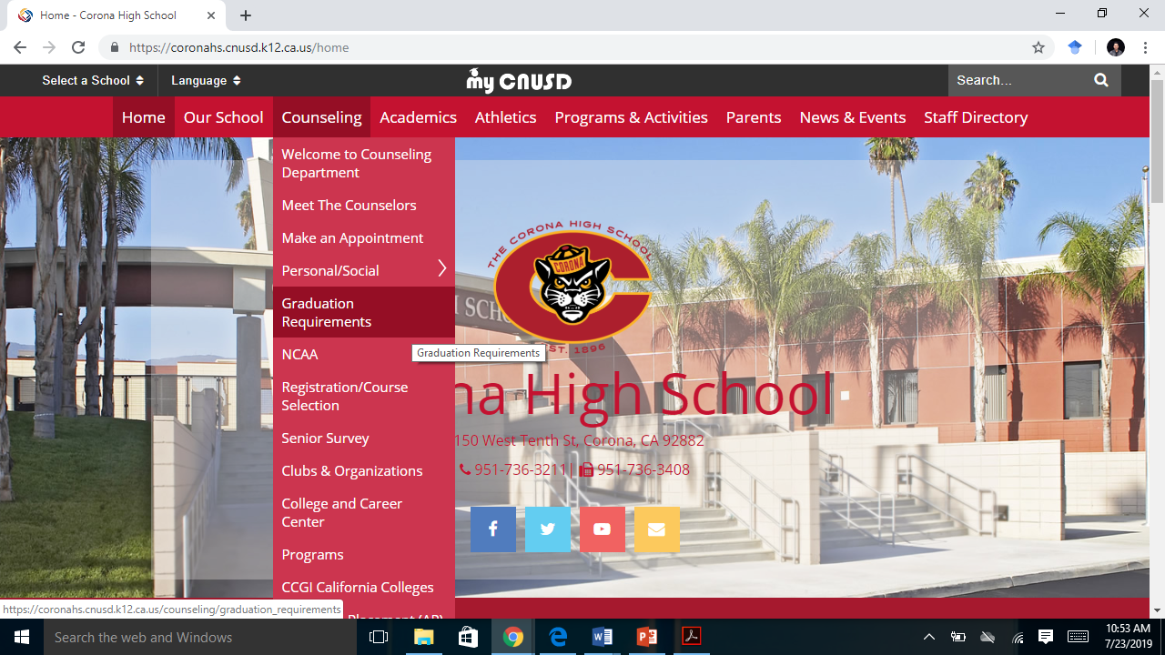
Get the information:
Visit CHS to find out about graduation requirements, important deadlines, NCAA student athlete apps and regulations or to make an appointment with your counselor.

Slide 3
Post-High School : Know your options
California Colleges provides students with an all inclusive guide to planning your college and/or career path.
For more one on one info, please visit CHS College & Career Center located in Room J1

Slide 4
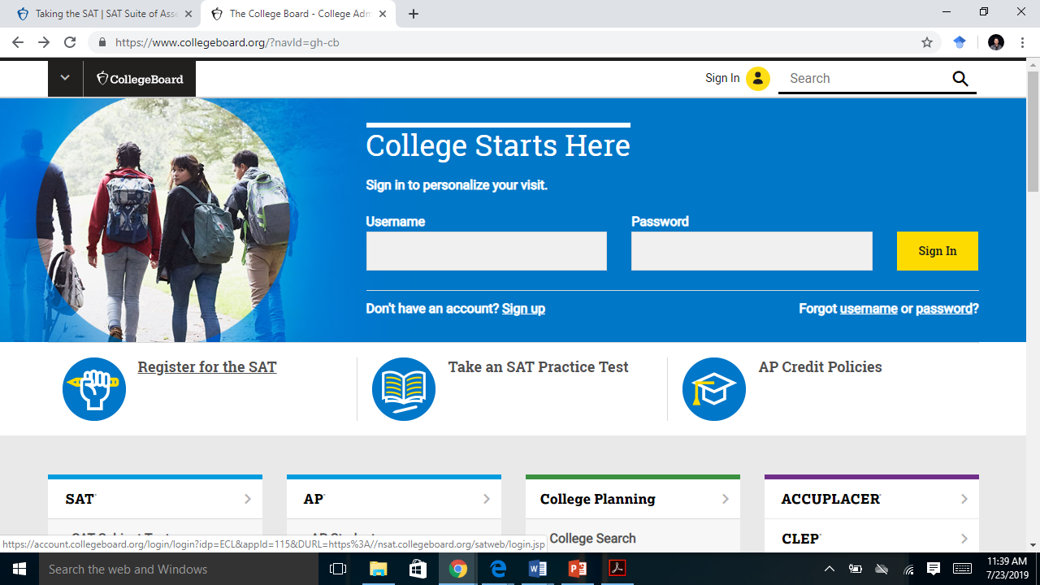
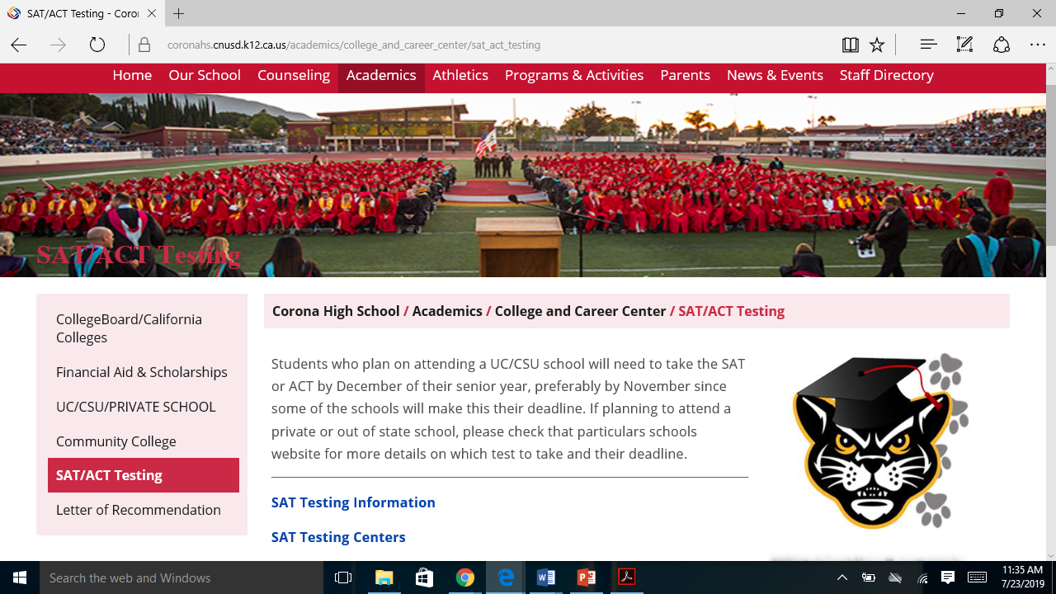
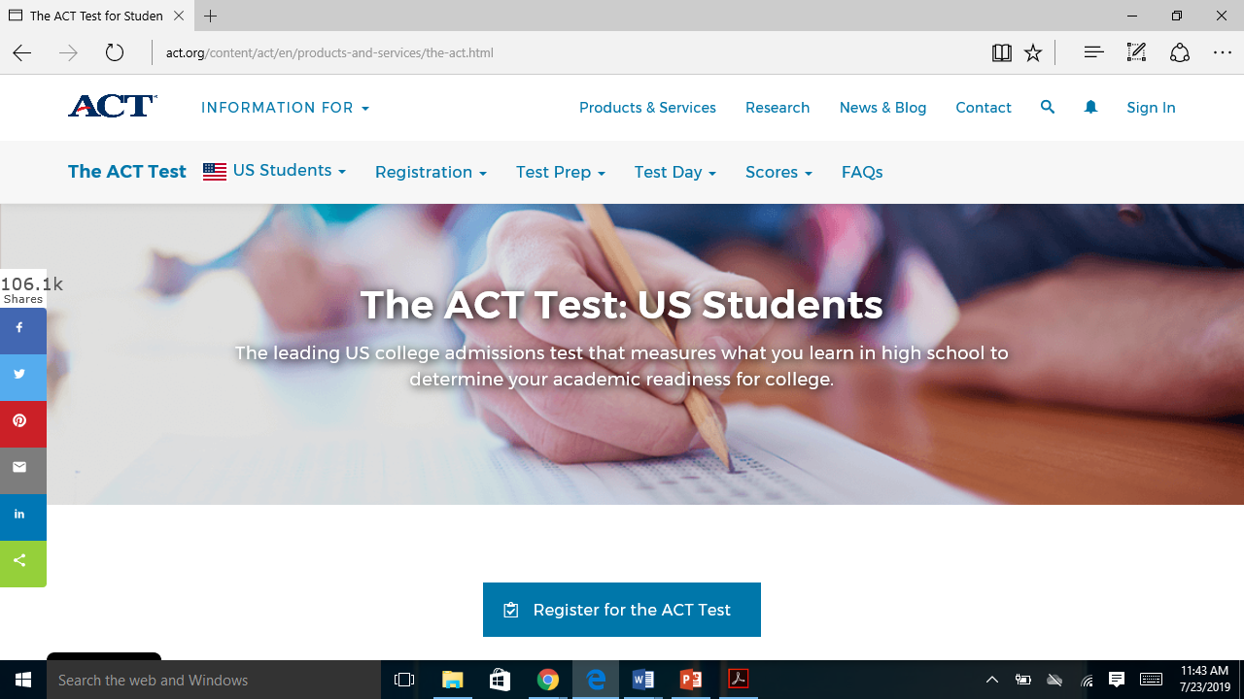
SAT / ACT
If you are planning on attending a UC/CSU school you will need to take the SAT or ACT by December of your senior year.
Check online to see your schools testing requirements.
Sign up for the SAT and various SAT subject tests at College Board
For more information on fee-waivers, please visit Ms. Kelly in J1
Sign up for the ACT at: ACTstudent.org

Slide 5
HOW MANY COLLEGES SHOULD I APPLY TO?
5-8 colleges is the recommended number. They should all be colleges you could see yourself attending.
It is good to apply to colleges that are both a bit of stretch as well as colleges you have a better feeling will admit you. (You never know!)
Most of your applications should feel like realistic matches!
SHOULD I STILL APPLY IF MY GPA & TEST SCORES ARE LOWER THAN THE AVERAGE RATE?
YES! Remember that colleges consider many different factors before extending admission. For example, your extra-curricular activities, recommendation letters, your admission essay and overall character are all important factors in the admission process.
For more info visit:
College Board: Applying to College FAQs

Slide 6
Important questions to consider:
Which campuses have academic programs that most interest me?
Do I want to be on a large urban campus or a smaller, more intimate one?
Do I want to be close to home?
What does my total cost after aid look like?

Slide 7
UC vs CSU:
Neither the UC nor the CSU system is better than the other – rather, students may be more suited to a particular system due to their academic and/or career goals.
There are 23 CSU’s throughout California, while there are only 9 UC’s.
Both UC & CSU require students complete the “A-G” courses with a grade of C or better.
For more information on UC admissions visit their Admissions page.
For more information on CSU admission visit their Admissions page.
CSU tuition costs are significantly lower than UC’s tuition rates.
UC’s are known for their more research based teaching styles, where CSU’s are more practical based.

Slide 8
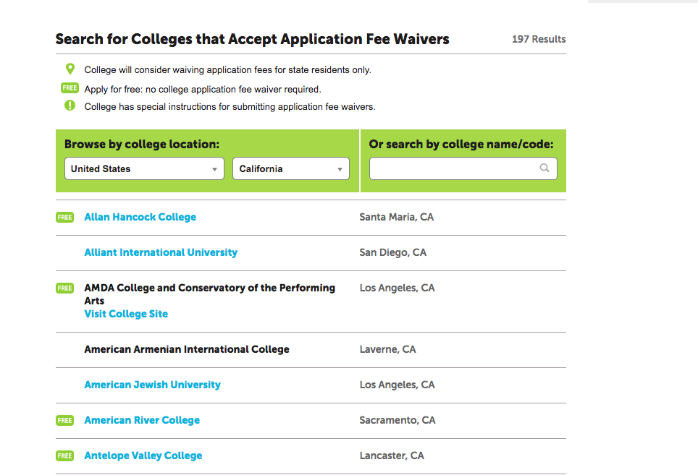
College Application Fee Waivers:
*College Application Fee Waivers are a great way to save money! While not every school accepts application fee waivers, there are many that do.
*For more info on eligibility visit the College Board Fee Waivers page.
*You can also visit our CHS College& Career Center.

Slide 9
EOP- Educational Opportunity program
For CSU:
The main purpose of EOP is to improve access of low-income students by making higher-ed more accessible.
EOP provides:
-Preadmission Counseling
-Orientation
-Summer Programs
-Diagnostic Testing
-Financial aid help/follow up
-Academic Advising
-Tutoring
-Learning Skill Services
-Personal and Career Counseling
-etc.
Interested students can start the application process by
pressing the appropriate EOP box on Cal State Apply

Slide 10
California community colleges
The largest higher education system in the nation, CCCs serve two million students each year across 114 colleges throughout California
Community College may be good for you if:
You are interested in lower tuition and/or more time to explore career options
You want more flexibility to work while going to school
You would like to prepare to transfer to a 4-year university- many CC’s have partnerships with local universities, including Cal-States and UC’s
Visit CCC Apply to create an account and find out more!

Slide 11
Applying
Review the admission eligibility requirements for the colleges that interest you and make sure your GPA and admissions exam scores will allow you to qualify for the college option of your choice. No matter what you decide, there are a variety of options that are sure to meet your needs as you begin college and prepare for your career.
CCCApply can be used for nearly all California Community Colleges (CCCs).
Cal State Apply is used for all California State University (CSU) campuses.
The UC Application is used for all University of California (UC) campuses.
The Common Application (Common App) is used by more than 800 public and private four-year colleges in the United States and abroad, including many in California. Schools not on the Common App membership list will have a school-specific application.

Slide 12
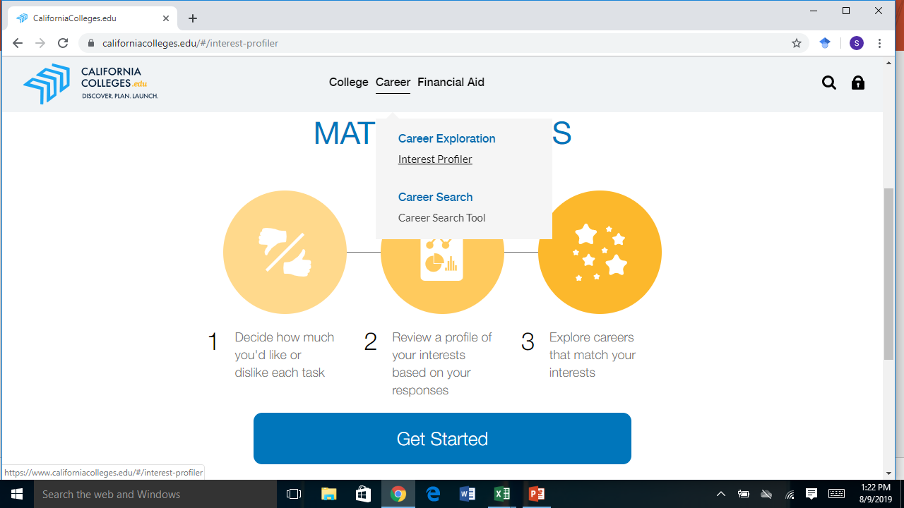
CAREER EXPLORATION
Have some idea’s about your future, but haven’t quite decided? Visit the Interest Profiler tab on California Colleges to discover what your interests are and how they relate to the world of work!

Slide 13
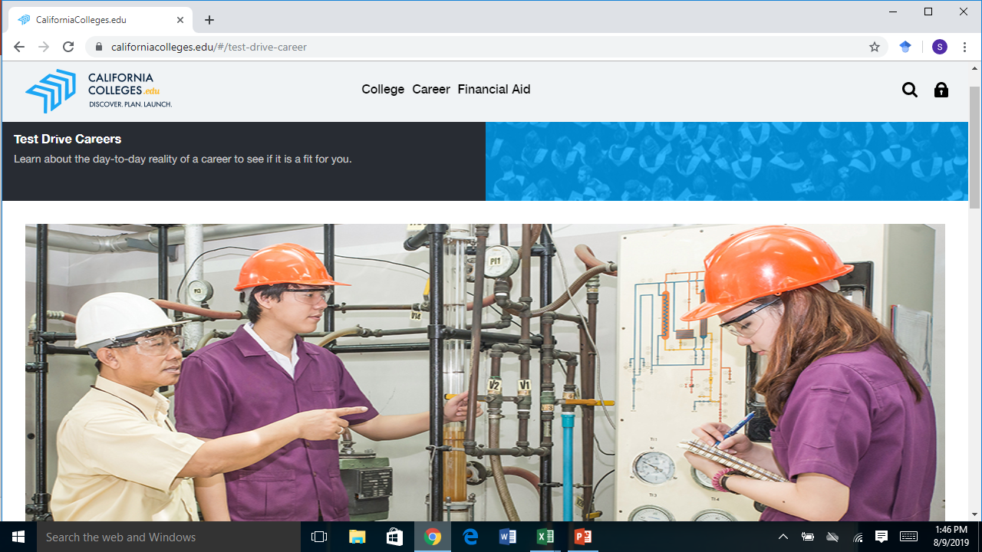
Test Drive Careers
Visit the Test Drive Careers tab at California Colleges to learn more about the day to day reality of a specific career.
Learn about different ways you can ‘test drive’ careers, through internships, job shadowing, and networking.

Slide 14
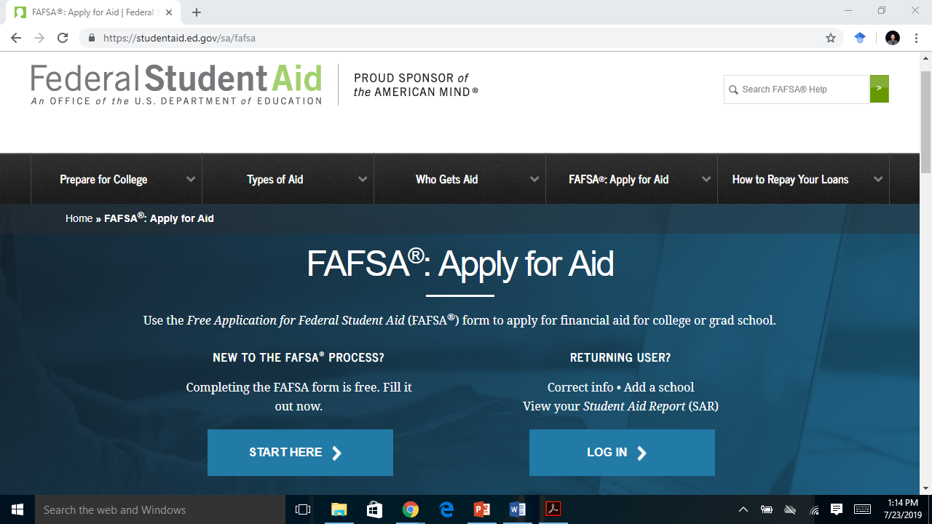
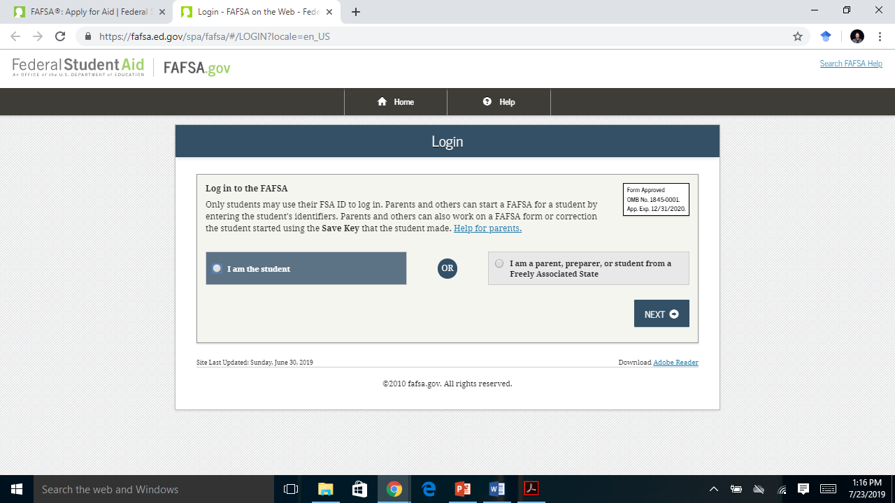
FAFSA
To apply for federal student aid, such as federal grants, work-study, and loans, you need to complete the Free Application for Federal Student Aid (FAFSA). Submitting the FAFSA is free and it gives you access to the largest source of financial aid to pay for school.
You can complete FAFSA at https://studentaid.ed.gov/sa/fafsa

Slide 15
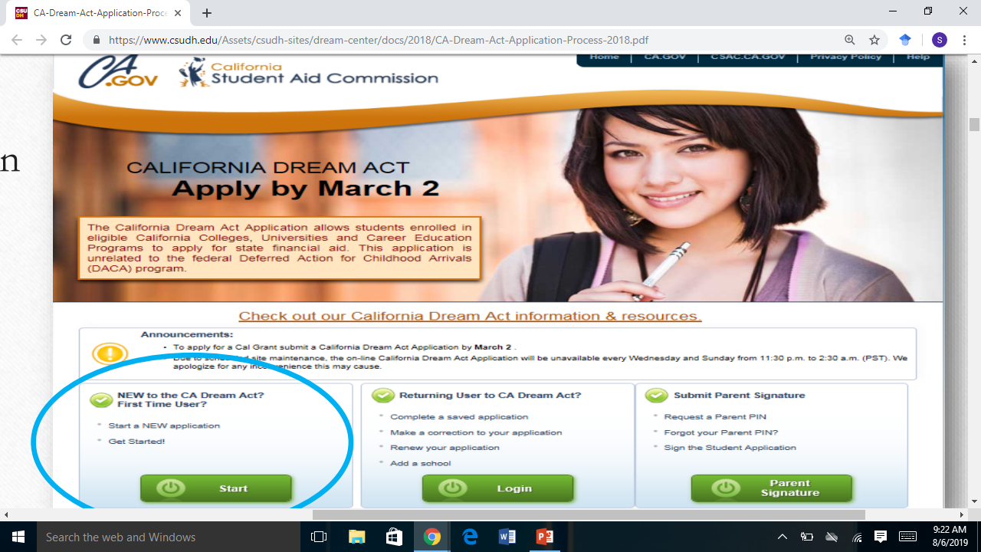
CA DREAM ACT APPLICATION
The California Dream Act Application is for undocumented students who meet the required criteria. It allows students interested in attending eligible California Colleges, Universities and Career Education Programs to apply for state financial aid.
FAFSA AID FOR DREAMERS INCLUDE:
*Cal Grant, Chafee Grant, Middle Class Scholarship
*UC Grants, State University Grant
*California Community College Promise Grant
*EOP/EOPS
*Private & Selected University Scholarships
APPLY BY MARCH 2.
For more information on application requirements and deadlines visit: California Dream Act

Slide 16
FAFSA OVERVIEW

Slide 17
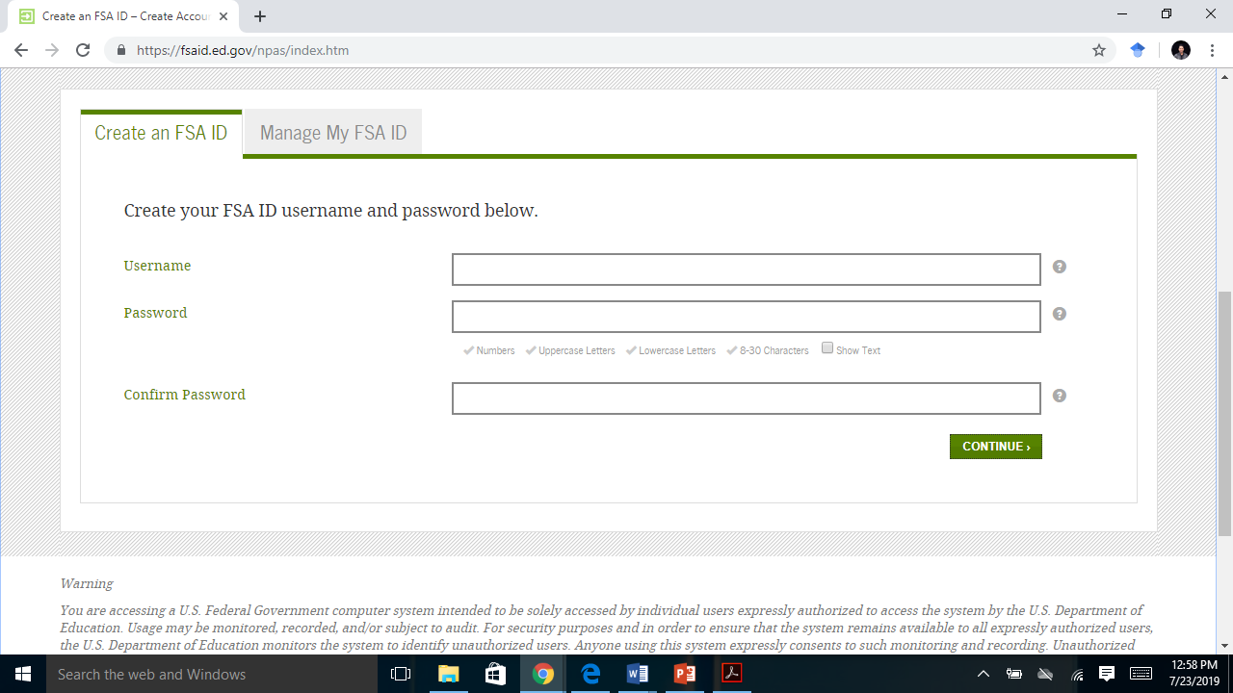
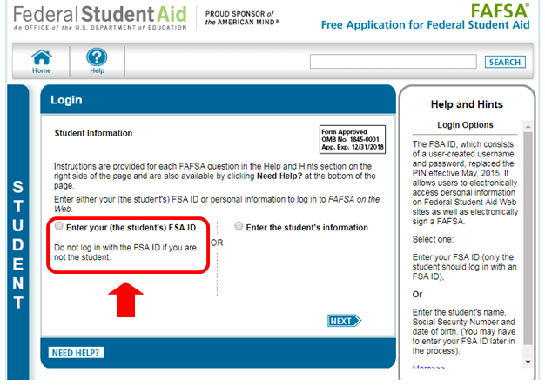
Creating an FSA ID:
What is an FSA ID? It is a username and password you use to log in to certain U.S Department of Education Websites, including fafsa.gov, StudentAid.gov, and StudentLoans.gov. You will also need this ID to electronically sign your FAFSA.
Visit FSA ID to create your FSA ID.
You will need your Social Security Number, full name and date of birth.
You’ll also need to create a memorable username and password.

Slide 18
California College Promise Grant
*Formerly known as the Board of Governors (BOG) Fee Waiver.
*Allows eligible CA residents enrollment fees to be waived at participating Community Colleges
*Must complete FAFSA in order to be eligible

Slide 19
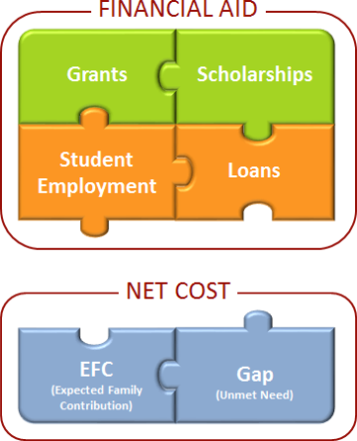
What happens after I submit the FAFSA?
EMAIL/MAIL
Students will be sent either email or paper-mail notifications regarding your financial aid award.
Students are usually sent an award-letter guide which contains important information on your student rights AND responsibilities as a financial aid recipient.
ACCEPT/DECLINE AWARDS
Students maybe instructed to accept or decline financial aid awards via their student portal
A detailed overview of awards, grants and scholarships as well as cost of attendance will also be found in the student portal

Slide 20
REMINDERS:
Always write down and remember your passwords ✔
Stay on top of all deadlines and know the requirements for your college choices ✔
Sign up to participate in Career Center College-Fair ✔
Make the time to visit college campuses that might interest you ✔

Slide 21
Important Dates:
October 1 : First day to submit CSU application
October 1: Filing period opens for FAFSA & California Dream Act
October 2: UC Insights Questions Workshop @ 7:30am in Library
October 3: Financial Aid Presentation
October 30: Financial Aid Parent Workshop (English & Spanish)
November 30: UC & CSU applications due
THANK YOU! If you have any remaining questions remember to speak to your counselors!

